Slide 1


Digital Health
UCSD Extension – Specialization Certificate
L0: Data Science for Healthcare
Hobson Lane, UC San Diego
Instructor
Notes:
<number>

Slide 2
Agenda
Slide | Topic | Description
3-10 | What is Data Science? | Science on data, accidental experiments Trial and error Data Science on “statistics” and “data science” Automation: machine learning and AI
11 | Digital Health Data Science course | syllabus
12-14 | Example | Kidney Disease, Precision, Recall
15-18 | Correlation and causation | Correlation: Mammograms prevent breast cancer death? Spurious correlation “Hill’s Criteria” Causal (influence) diagram
19-21 | Bayes Rule | Formula Probabilities for breast cancer and mammograms Mammogram accuracy
22-24 | Deep Learning | Multi-layer regression Neural network playground Explaining the black box
25-27 | Assignments | Quiz & homework

Slide 3
What is Data Science? How does it apply to Healthcare?

Slide 4
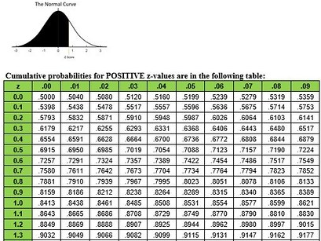
What is Data Science?
X
science on data
test
Y
Hypothesis
Data
X
Y
Cause
Effect
predict

Slide 5
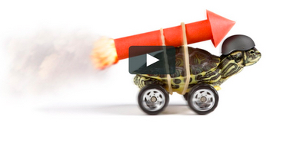
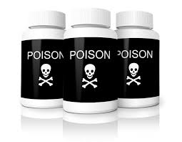
Advantages of the Data Science approach
Accidental experiments are often…
Faster
Cheaper
Better
$
More ethical

Slide 6
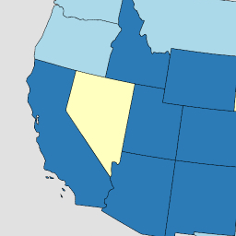
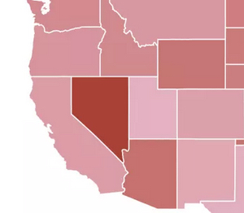
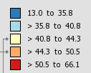
Smoking → Lung Disease
Lung & Bronchus Death Rates
(per 100,000)
6
28
3
California
Nevada
Utah
2243
19
Daily smokers
X
Y
Smoking
Cancer
28%
43
19
4%
19
99.98% Correlation
2% P-value
6%
22

Slide 7
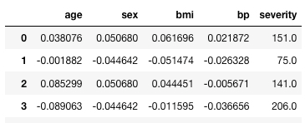
Trial and Error
Trial model
(Hypothesis)
predicted
label
Diabetes data
Error
features (indicators)
label
151.0
-
123.4
=
27.6
true label

Slide 8
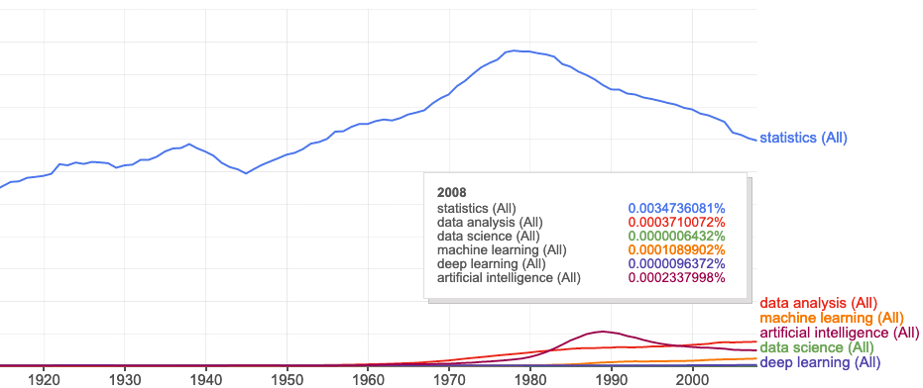
Data science on “statistics”
books.google.com/ngrams

Slide 9
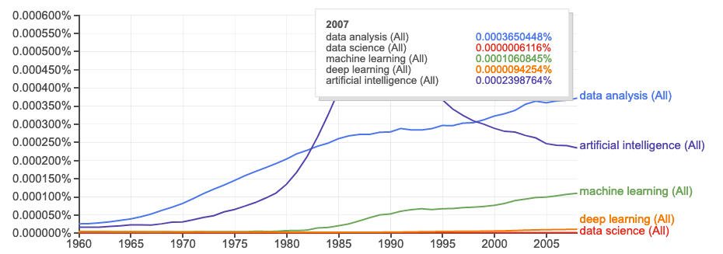
Statistics about “data science”
Peter Naur
“datalogy”
“data science”
books.google.com/ngrams

Slide 10
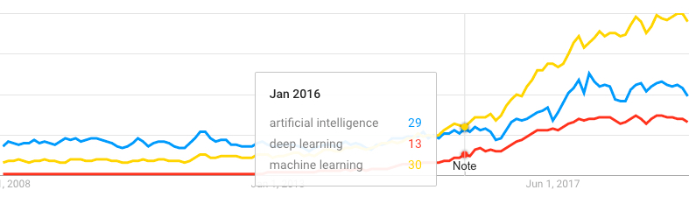
Web search trends
Machine Learning
Artificial Intelligence
Deep Learning
trends.google.com

Slide 11
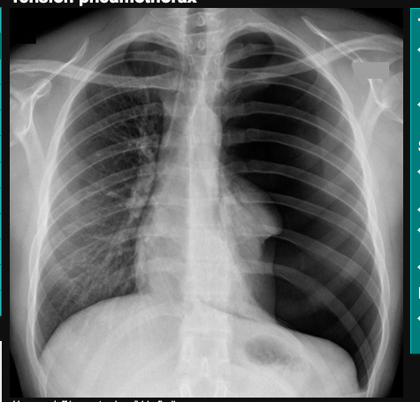
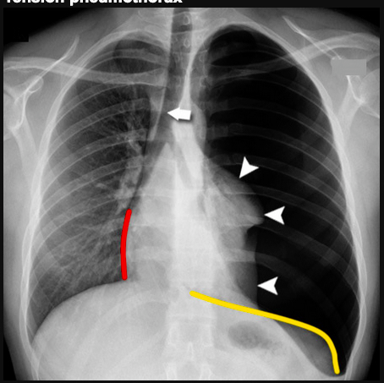
Automation
Statistics
Science
Data Analytics
Data Science
Predictive Analytics
Machine Learning
Deep Learning
Artificial Intelligence (AI)
Automation
Fear
Unexplainable
(black box)
"Z Tables" by sustainablerural is licensed under CC BY 2.0
radiologymasterclass.co.uk

Slide 12
Syllabus
Wk. | Title | Topics | Exercise
1 | Data Science in Healthcare | applications, terminology, HIPPA | anonymize dataset PII
2 | Spreadsheet Data Science | ETL, exploration & visualization | height, weight, BMI, gender
3 | Statistics | causality, correlation, MLE | causal diagram “games”
4 | Clinical Data Science & Machine Learning | PII, prescriptive vs descriptive | predict diabetes risk
5 | Deep Learning & AI | neural nets, radiology, CV | train diagnostic neural net
6 | Hospital Performance Modeling | time series, unintended conseq. | Mid-term Quiz!
7 | Population Health (Epidemiology) | GIS, spatio-temporal modeling | visualize/analyze Ebola
8 | Scoping Review & Gap Analyses | diabetes, military women | review smoking research
9 | Natural Language Processing | IA, summarization, text mining | find summary with spaCy
10 | Occ. Health & Assistive Tech. | Tesla & Aira case studies, OSHA | analyze medicine OCR app.
11 | Public Policy, Privacy and Ethics | bias, fairness, anonymization | Final Exam!
Proj | Train your own healthcare model | find/download data, ETL, | fit/train a DS model

Slide 13
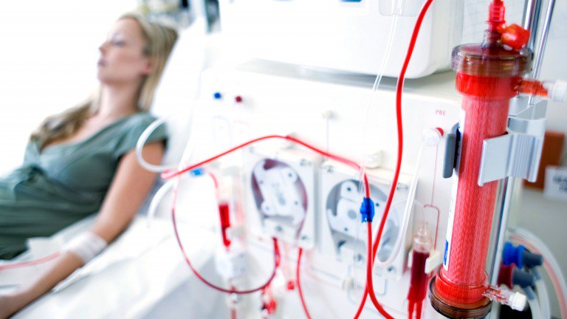
Example Application: Predict Kidney Disease
Clinical records can predict Kidney failure
2 days in advance
55% accuracy for acute problems
90% accuracy for serious issues
Dataset:
100% UK citizens
100% military
90% male
DeepMind (London)

Slide 14
Precision
Of all the positive results how many were correct?
Positive predictive value
True positive rate
True_Positive_Count / (True_Positive_Count + False_Positive_Count)

Slide 15
Recall
Of all the patients with the disease how many were correctly “recalled” (predicted) by the test?
Sensitivity
True_Positive_Count / (True_Positive_Count + False_Negative_Count)

Slide 16
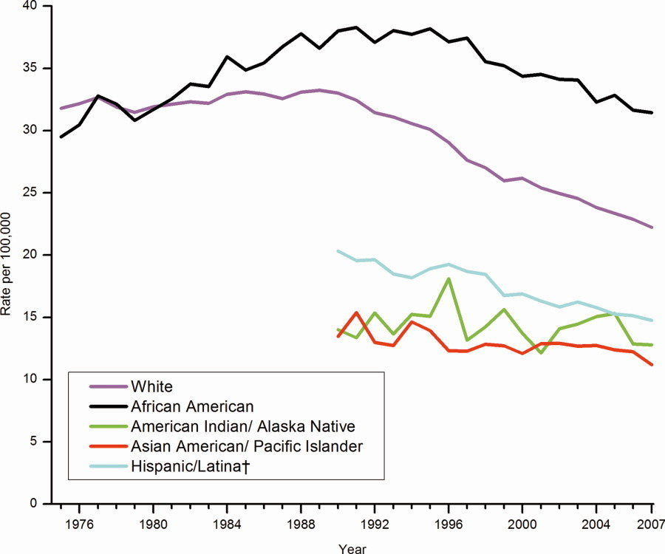
Correlation enables prediction
Breast Cancer Rates 2011: bit.ly/ucsdbreast

Slide 17
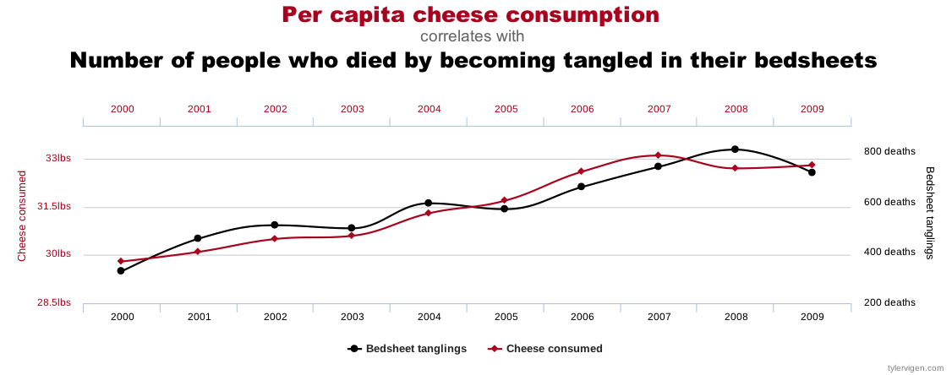
Correlation is not enough
Computers are good at finding patterns
But often those patterns are “spurious correlation”

Slide 18
The “Bradford Hill Criteria”
1. Consistency: multiple studies, datasets, subjects
2. Strength: correlation magnitude
3. Dose-response: increased dose = increased effect
4. Specificity: 1 effect rather than many
5. Temporal relationship: cause before effect
6. Coherence: biological plausibility

Slide 19
Cause or Confounder?
Other?
age
genetics
diet
environment
pregnancy
surgery
drugs
education
urban/rural
Mammogram
frequency
Wealth
Ethnicity
Gender
Cancer
death
rate

Slide 20
Bayes Rule
Updated Probability = Likelihood Ratio x Prior Probability
$P\left(DlT\right)=\frac{P\left(TlD\right)}{P\left(T\right)}×P\left(D\right)$

Slide 21
Bayes Rule Example
Prior | P(D) | Probability of getting breast cancer | 1 in 700 per yr 1 in 70,000 (men)
True Positive Rate (Sensitivity) | P(T|D) | Probability of mammogram detecting cancer | .73
False Positive Rate (False Alarm) | P(T|~D) | Probability of positive mammogram w/o cancer | .12
Positive Rate | P(T) = P(D) * P(T|D) + P(~D) * P(T|~D) | Probability of a positive mammogram among all women | .73 * 1 / 700 + .27 * 699 / 700 = .121

Slide 22
Real Numbers
P(D) | 1/700
P(T|D) | .73
P(T) | .121
$P\left(DlT\right)=\frac{P\left(TlD\right)}{P\left(T\right)}×P\left(D\right)$
$P\left(DlT\right)=\frac{.73}{.121}×\frac{1}{700}=.0086≈1\text{\%}$

Slide 23
Deep Learning
Regression works for small numbers of “features”
Regression can be distracted by spurious correlations
Feature engineering is the hardest part of Data Science
What if we layered regressions on top of each other to create a “deeper” model?

Slide 24
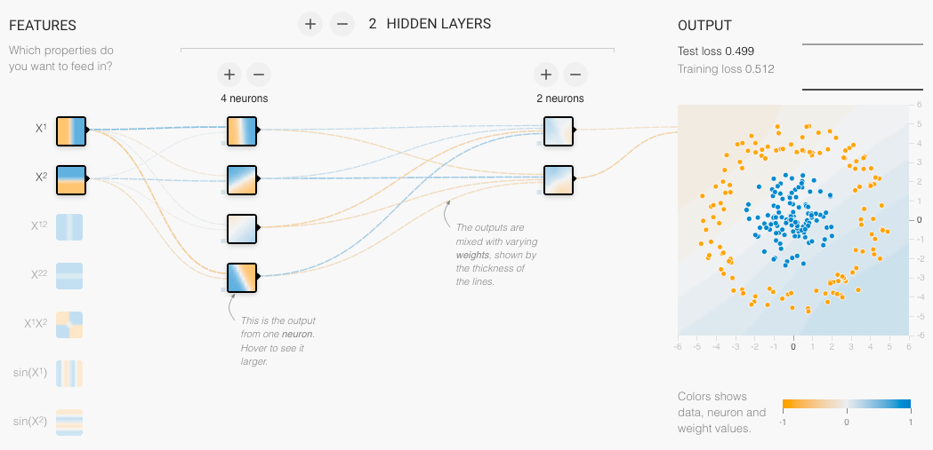
Neural Network
Neural Net Playground: bit.ly/ucsdnet

Slide 25
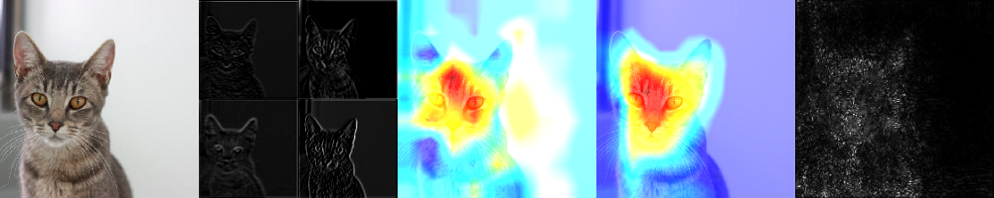
Explainability
Image
Activations
Importance
(Occlusion Sensitivity)
Grad CAM
(Gradient-weighted Class Activation Map)
SmoothGrad
Grad CAM: bit.ly/ucsdcam
tf-explain: bit.ly/ucsdexplain
SmoothGRAD: bit.ly/ucsdsmooth

Slide 26
Assignments

Slide 27
Quiz
Give two applications of Data Science to Health care
How is Deep Learning applicable to Health care?
Will Artificial Intelligence replace doctors?
Why or why not?
If a blood test for a particular disease has a False Positive rate of 10% and a False Negative rate of 30%, what’s the test’s precision (positive predictive value) and recall (sensitivity)?
Notes:
<number>

Slide 28
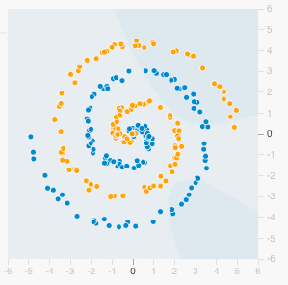
Homework: Play with Neural Nets
Visit playground.tensorflow.org
Select the spiral dataset and add 20% Noise
Add and remove different combinations of features: x1, x2, x1^2, x2^2, x1*x2, sin(x1), sin(x2)
Play around with different numbers of “HIDDEN LAYERS” and neurons per layer.
How many features, hidden layers and total neurons do you need achieve < 15% test set loss?
Notes:
<number>

